Slide 1

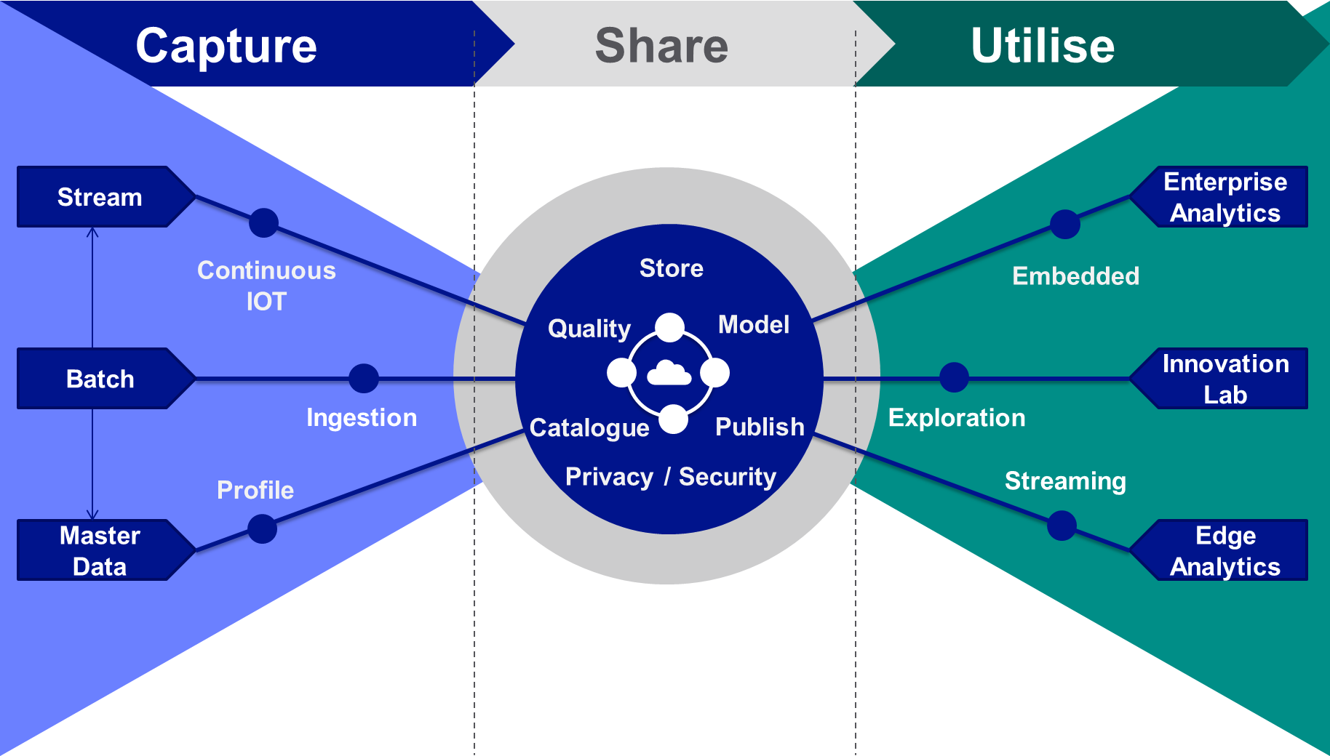

Group Data Strategy
Releasing value with data
What is the business imperative?
What are the challenges?
Data is critical for the success of the Digital Strategy:
engage our customers
improve asset health
help our employees perform
Our business units face common challenges, which we can solve collaboratively
Trust in data – Quality of data, data replication
Access to data – Siloes, tech proliferation
Value from data – Time to market
What will we do?
Value first approach (Right to Left thinking)
Capture: Manage data by mastering, cataloguing and cleansing
Share: Liberate data from source, enabling utilisation, securely
Utilise: Outcomes driven, incremental value. Innovation enabling

Slide 2
Group Data Strategy
How will we do this?
Capture:
Identify and prioritise master data issues across BUs and deploy Reltio to resolve
Use the Enterprise Data Platform to catalogue, manage, master and govern data
Utilise:
Implement a value first method to capture use case outcomes enabling incremental value releases
Follow a common analytics architecture to enable reuse, whilst supporting innovation
Digital MVPs – evolve to a data products approach
Share:
Establish the Enterprise Data Platform as the common repository for analytical workloads across the company by end FY23
Data privacy and security classifications built into data catalogue allowing for automated role based access

Slide 3
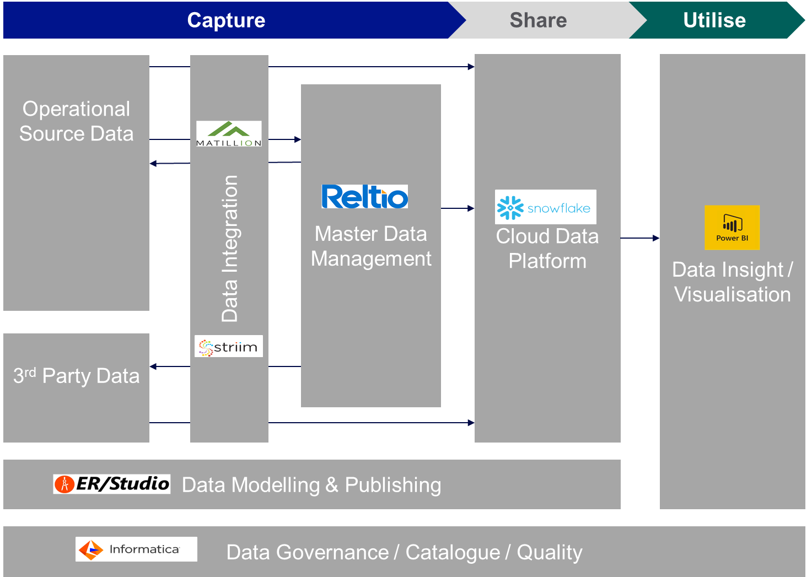
Group Data Strategy
Technology Strategy – Shared Enterprise Data Platform
We have established a shared Enterprise Data Platform in line with a common reference architecture, which is extendable. This sets technology standards for Data capabilities.
The Enterprise Data Platform (built out by the NG D&A Strategy) will evolve to be part of the GridStack ecosystem
Enterprise Data Platform
Digital products & services layer products:
Systematically modularize product and product components to enable re-use, faster/lower-cost development, and speed to scale
Provide Developers on Product Teams with consistent best-practice tools for development, release and maintenance
5
6
7
GridDesign
Integration Products:
Connect different products and layers, allow for ease of inter-operability and speed of integration
Security Products:
Protect sensitive data & information; ensure high standards for privacy and compliance
Org capability and ways of working:
Establish effective digital WoW and processes to optimize intake process, funding, federated org structure, and talent model
1
GridApp
Focus of NG Data Strategy
GridInit
Data & analytics layer products:
Systematically liberate data from legacy core systems
Systematize/ modularize D&A products services for Prod. Teams
Provide D&A developers on Product Teams with consistent best-practice tools
2
GridInsights
GridDataAssets
GridLake
Core systems products:
Use layers above to reduce need for direct core system access
De-couple simplification and replacement of core systems from build of new "upstack" digital products
3
GridCRM
GridPlanning
GridAssets
Infrastructure products:
Modernize infrastructure with flexible options for Product Teams
Allow easy adapt-and-configure of Infrastructure as Product needs evolve
GridFunctions
GridIdentity
GridStream
4
GridContainers
GridModels
GridAccess
GridDevices
GridSpecs
GridVault
GridDB

Slide 4








Group Data Strategy
How will we do this?
Data Operating Model
Global: IT Data Office
Entity: Business Unit / Function
Data Analytics Strategy
Promote and advance analytics culture, capability and strategy
Data Architecture
Promote and advance business enablement through data
Data Analytics
Effective generation of performance, operational & regulatory reporting
Data Science
Exploit data to generate insight and improve decision-making & operations
Group
Entity
Data Engineering
Deliver and maintain data solutions through data engineering
Data Governance & Assurance
Promote and advance data standards, culture and governance
Data Operations
Deliver improvements in data quality, cataloging and mastering
Data Governance
Promote and advance data standards, culture and governance
Group Operating Model – People & Process:
A Federated Data Strategy approach requires a hub and spoke organisation
The Target Data Operating Model will continue to evolve, and will learn from the Digital MVPs

Slide 5
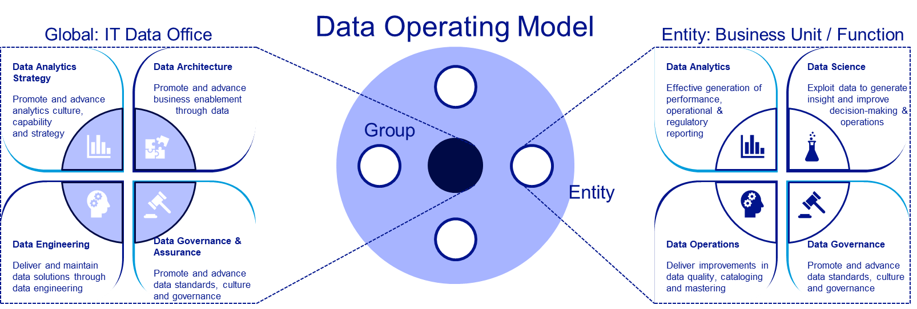
Group Data Strategy
How will we do this?
Group Operating Model – Delivery:
Group Data is set up to deliver data platforms and ‘Capture & Share’
BUs should establish capabilities to ‘Utilise’ and deliver value
This model is not the target, and will need to transition to a more ‘Digital’ model over time

Slide 6
Appendix

Slide 7
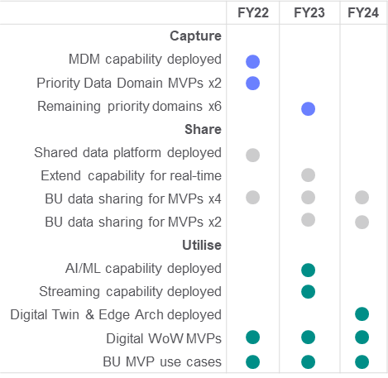
Group Data Strategy
Releasing value with data
Bring together the necessary capabilities and a culture of managing data as an asset, to constantly innovate and release optimum business value with data
What is the business imperative?
What are the challenges?
What will we do?
Data is critical for the success of the Digital Strategy, to:
engage our customers
improve asset health
help our employees perform
Our business units face common challenges, which we can solve collaboratively
Data siloes, technology proliferation and long running transformation plans must be resolved to make data access faster, improve visibility of data quality and to enable data management
Data replication across multiple systems is creating operational and analytical issues and cost
Our BUs don’t have the skills to manage data across the lifecycle
Establish a value first approach to analytics investment, incrementally increasing value, data accessibility and trust. Evolve to digital ways of working.
Focusing around three pillars to accelerate the BUs:
Capture: Manage data by mastering, cataloguing and cleansing
Share: Liberate data from source, enabling utilisation, securely
Utilise: Enable analytics delivery and innovation
Alignment to NG Priorities
How will we do this?
When will this happen and at what cost?
Identify and prioritise master data issues across BUs and deploy Reltio to resolve
Use the Enterprise Data Platform to catalogue, manage, master and govern data
Implement a method for all data projects to capture use case outcomes and value enabling incremental value releases
Follow a common analytics architecture to enable reuse, whilst supporting innovation
Digital MVPs – move to data products approach
What will this enable?
Engaged customers;
360 view of customer
Behaviour analysis
Impact analysis
Asset health;
Asset health analysis
Fault prediction
Preventative maintenance
Storm impact forecasting
DER capacity planning
Forecasting EV rollout
Digital Employee;
Remote analysis
Workforce planning
Asset analytics for engineers in the field
Safety analytics
Costs (4 BU 2 Entities)
(5-year cumulative FY22-26)
Strategy Benefits
(5-year cumulative FY22-26)
Establish the Enterprise Data Platform as the common repository for analytical workloads across the company by end FY23
Data privacy and security classifications built into data catalogue allowing for automated role based access
Entityx2
£15M
Efficiencies
£39M
£139M
TOTEX
£281M
BUx4
£31M each
Transformational value
£242M

Slide 8
Group Data Strategy
Horizon Mapping
The strategy is to accelerate the NG grid journey to becoming an organisation that can get optimum value from its data, when it needs to, where it needs to, for whoever (or whatever) needs it, enabling the business’s visions and the Digital Strategy. The strategy will do this by resolving current issues and challenges around accessing and trusting data and building new capabilities that will enable the business to transform for a Digital Future. We will build our capability to support the businesses’ transition to a DSO including collecting & storing real time & non-real time data as well as providing tools to create AI/ML, Predictive Analytics and Digital Twin capabilities
Horizon 1 (FY22)
Value first, accessible, trustworthy data
Horizon 2 (FY23)
Increase value with Data Science
Horizon 3 (FY24)
Enable future; DSO, Digital Twins, Edge
Overview | Establish incremental, value first delivery, incorporating Digital WoW and GridStack | Increase BU data capabilities, value first, through enterprise standards for data science and near real time analytics. | Combine stored data, data science and real time streams to introduce higher value use cases
Value | Data onto EDP: Customer, Electric, ET, HR Master data MVP: Customer & Employee Digital WoW MVP: Customer & Electric Use cases under consideration: Customer segmentation, channel utilisation, asset health analysis, Grid reliability analysis, legacy reporting migration | Data Science MVP: Customer, Electric, ET, HR Master data MVP: Asset, Finance Data onto EDP: GBU, Finance Use cases under consideration: TBC | Leverage capabilities and data to enable: Smart, automated network Digital Twins (assets and network of assets) Monetisation opportunities
Capability | Enable the following capabilities for BUs: Capture: Data ingestion, Master Data Mgt Share: Data Quality, Data Catalogue, Business Glossary, Data Repositories, Data Modelling Utilise: BI, Visualisation, APIs | Enable the following capabilities for BUs: Capture: Streaming ingestion Utilise: AI/ML, Common Data Science Lab | Enable the following capabilities for BUs: Capture: Edge analytics Share: Complex rules engine Utilise: Edge analytics, simulation modelling

Slide 9
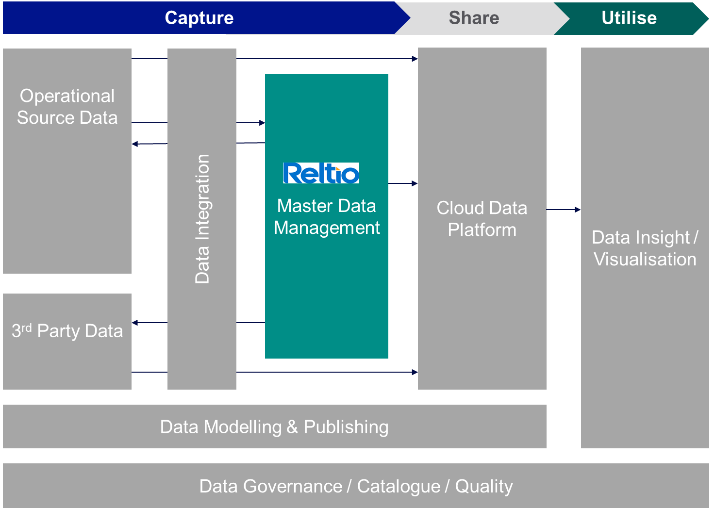
Group Data Strategy
Capture: Master Data focus
The FY22 Focus for Data Strategy ‘Capture’ is to ensure data required to drive value uses cases is captured, managed and governed in line with the NG Data Management Framework. This will focus on agreeing data ownership, cataloguing and reviewing data condition, classifying master data, its sources, failure costs and where needed implement data quality, governance and master data solutions to build in quality and simplify the data landscape to create trusted data.
The Challenge
The definition, capture, mastering and governance of our data is inconsistent and not of a maturity that supports our digital ambitions
Many sources of partial truths
No single source of truth / system of record
Data is not stored, used, or available in standardized ways
Poor levels of data quality and governance
The Strategy
All data projects will apply the NG data management framework; cataloguing, quality reporting and governing data. If master data issues are identified (or already understood), then this will also form part of the project requirement to resolve.
Master data issues will be resolved by setting a master data “golden record” for the key domains which will provide a single source of trusted, mastered data.
The Roadmap
Q1: Complete MDM contract
Q2: MDM deployed on shared data platform & MDM common re-use artefacts built
Q2-3: US Customer Master/Governance MVP & Workforce Master/Governance in-flight
Q3-4: US Electric Asset Master/Governance & UK ET Asset Master/Governance initiated
Q4: Scoping future MVP’s for US Gas, Finance & Vendor
Some key data domains are spread across multiple IT systems:
Master Data Solutions underpinned by the Enterprise Data Platform to enable ‘golden record’ creation/maintenance:
Master data priority areas / domains…
US Customer
Workforce
US Electric Distribution Assets
US Electric Transmission Assets
UK Electric Transmission Assets
Finance Cost / Vendor
US Gas Assets
Workforce SuccessFactors SAP ECC US SAP ECC UK Fieldglass ACG Database | US Customer CSS CRIS Salesforce | Gas Assets Maximo SmallWorld GIS | Electric Assets Smallworld GIS (Dist Assets); Cascade (T&D Substations); Powerplant; Computapole; STORMS;

Slide 10
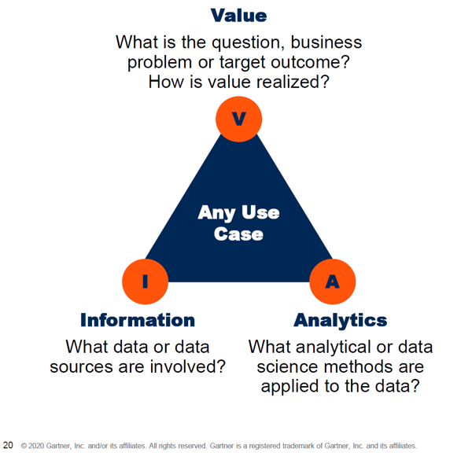
Group Data Strategy
Share: Enabling trusted access to data
The FY22 Focus for the ‘Share’ Data Strategy is to accelerate the release of value from data by shifting to an incremental data delivery model. Once data is shared on the Enterprise Data Platform it can be accessed by multiple consumers and will build up a common source of BU and Global data. The reference architecture is extensible and is being built out in line with demand. Privacy and security are priority requirements and common across BUs so we will establish a common approach with lead BUs.
The Challenge
The business needs faster, secure access to data delivered in an efficient and scalable way:
Current approaches to delivering data are costing too much and taking too long
Analytics is becoming pervasive and the sources of data are changing and growing
Data Laws and regulations are changing, in conflict with an increasing urgency for data from the business
The Strategy
Establish a common portal for Enterprise data
Data transformation projects will be use case driven and incremental
Data architecture will enable all types of data and analytics: volume, velocity, variety
Privacy and security will be designed in
The Roadmap
Q1: Shared data platform established
Q2: Privacy and Security design established with lead Business Units (Electric and Customer)
Q2: Electric priority use cases initiated
Q2-3: Customer priority use cases initiated
Q2-3: ET priority use cases initiated
Q2: Finance priority use case discussions
Data transformation projects will be built incrementally in line with value. Projects will follow a value based model to ensure value is understood for each release.
Gartner VIA Model
We have established a shared Enterprise Data Platform in line with a common reference architecture, which is extendable.

Slide 11
Group Data Strategy
Utilise: Driven by use cases
The FY22 Focus for the ‘Utilise’ Data Strategy is to establish value based use cases for all proposed projects, to align this approach with the NG Digital Strategy and to start releasing value from data incrementally.
The Challenge
Utilization of data is currently hindered by a lack of access to data, trust of data, and understanding of data. This limits data innovation to unlock further business value:
Funding approach limits provisioning of tools, data and skills to define use cases and build analytical solutions
Captive data in 3rd party systems with limited transparency and complexity to approve, build & use new integrations
Lack of clarity around tooling approved for use for data & analytics leading to misaligned solutions design
The Strategy
Adopt a Digital delivery model that extends into the use of data as well as digital product development. In particular:
Value-led: Data utilization driven by use case value
Customer centric data products: Data products developed, measured and evolved through an iterative product lifecycle
Leverage shared data: Trusted data available for use without overheads
The Roadmap
Q1: AI/ML tooling standard initiated
Q2: Establish a reusable method for defining data value use cases (ET)
Q2: Electric and Customer Digital use case MVP
Q2: Roll out reusable value use case method to all new data projects
Q3&4: Use value approach to establish data value for FY23 proposals
Data Product Lifecycle
The Enterprise Data Platform (built out by the NG D&A Strategy) will evolve to be part of the GridStack ecosystem
Value driven use case or initiative determines need for data
Available data products required to support use cases identified and self discovered
Data product
team
formed if
required
Digital products & services layer products:
Systematically modularize product and product components to enable re-use, faster/lower-cost development, and speed to scale
Provide Developers on Product Teams with consistent best-practice tools for development, release and maintenance
5
6
7
Enterprise Data Platform
GridDesign
Integration Products:
Connect different products and layers, allow for ease of inter-operability and speed of integration
Security Products:
Protect sensitive data & information; ensure high standards for privacy and compliance
Org capability and ways of working:
Establish effective digital WoW and processes to optimize intake process, funding, federated org structure, and talent model
1
GridApp
Focus of NG Data Strategy
GridInit
Repeat
Data & analytics layer products:
Systematically liberate data from legacy core systems
Systematize/ modularize D&A products services for Prod. Teams
Provide D&A developers on Product Teams with consistent best-practice tools
Enhanced
data
product
evolved
and
shared
Start
use case
product
development
w/data
product
enhance.
2
GridInsights
GridDataAssets
GridLake
Core systems products:
Use layers above to reduce need for direct core system access
De-couple simplification and replacement of core systems from build of new "upstack" digital products
3
GridCRM
GridPlanning
Iterative development
of use case and
data product
GridAssets
Infrastructure products:
Modernize infrastructure with flexible options for Product Teams
Allow easy adapt-and-configure of Infrastructure as Product needs evolve
GridFunctions
GridIdentity
GridStream
4
GridContainers
GridModels
GridAccess
GridDevices
GridSpecs
GridVault
GridDB

Slide 12
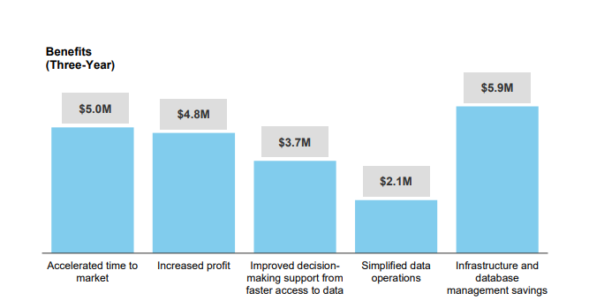
Group Data Strategy
Costs & Benefits Breakdown
The benefits of this strategy come in two forms; First the efficiencies of following a federated strategy which sets a common approach for the BUs to deliver against, the second benefit comes from achieving the transformational value faster. The transformational value is a combination of unlocking new value, supporting faster decisions and realising value faster. The costs have been extrapolated from the UK ET & GT RIIO2 5 year assessment for data transformation. Benefits originated from a Forrester assessment.
Strategy Benefits
(5-year cumulative FY22-26)
Transformation benefits based on Forrester research of the value of cloud based analytics transformations.
Accelerated time to market, Increased profit and Faster decision making have been converted to a 5 year, 4 BU £ number.
Efficiencies
£39M
Strategy efficiencies have been based on the savings that will be achieved by the BUs following a consistent federated strategy.
Also, by following the federated strategy, BUs will accelerate to deployment and start realising the significant transformation benefits earlier
Transformational value
£242M
£281M
Additional Transformation benefits based on reducing the cost of bad data are based on the BCG analysis of NG
Forrester benefits analysis of a cloud data platform vs a disparate, siloed hybrid data landscape
Costs (4 BU 2 Entities)
(5-year cumulative FY22-26)
Entityx2
£15M
BU delivery costs have been extrapolated from the ET & GT 5 year RIIOT2 cost planning data.
£139M
TOTEX
BUx4
£31M each

Slide 13
Group Data Strategy
Cost of Bad Data
This data strategy can reduce the costs of bad data that NG faces, indicating value at stake of [$50M] to [$60M] annually
Direct cash costs
Lack of benefits realization
Risk to the business
1
2
3
Bad data creates incremental cash costs for digital programs and to run the business.
These costs occur through additional employee, contractor, and system/tool costs required to fix or work around data issues; and these solutions are not scaled across programs
Examples include:
~$2M spent in GBE on data cleaning
$5-8M spent on manual integrations to sync data
~$1.5M spent on manual finance reporting and data processing
Data complexities can reduce the benefits from various programs:
Programs don't fix data problems across the domain
Poor data reduces efficiency and accuracy of digital solutions
Incompatibility of solutions across Grid (e.g CSS vs CRSS, UK vs US)
Best minds occupied doing data clean up vs innovating solutions
Examples include:
$40-50M of delayed annual benefit due to data problems affecting GBE
$1.5M of Data Scientist time being spent on remedial data cleaning
Exponential data growth with the modernization of the utility sector poses further risks if data is not managed correctly.
Examples include:
Utilities are held to account if data existed to prevent an incident, and this data was not used correctly to prevent the incident
Competition from companies who can better extract insights from data to deliver more efficient outcomes
Increased regulatory accountability in utility performance, with productivity metrics for approved investments, requiring data on fiscal spend and output achieved

Slide 14















Key Benefits – Snowflake Cloud Data Platform
Multi Workload
Lower Cost Improved Experience Distinct Feature
Full SQL capabilities across traditional capabilities from operational to data science. Python, R, Java and Native Rest API extends usability – includes structured, semi-structured and unstructured
Compute & Storage
Zero Management
Time Travel & Zero Copy
Streaming Pipelines
Compute resources decoupled from storage allows multi-workload (r/w isolation) and pausing to reduce costs along with usage measured in seconds (vs hours) vs Synapse Resource Pools that are dedicate and tightly-coupled.
Automatically handles infrastructure, optimization, availability, data protection, and schema detection.
Up to 90-day point in time precision history. as well as virtual copies of data (zero copy) Built-in High-Availability via Time Series and Zero Copy all as “Out-of-the-Box” capabilities.
Stream tasks can be configured to automatically generate history (CDC). Serverless architecture for low cost and maintenance with strong IoT support (native – no other tools required)
RBAC + Masking
Column level security via roles with multiple masking profiles – no code or developer input needed.
Security & Availability
Geo-Spatial
Integrated Platform
Data Sharing & Marketplace
Data Analytics & Science
Geographical data type uses round earth coordinate - good out-of-box performance that handles bulk of use cases. Native operations (e.g., distance between) handled natively…in SQL
SOC Type 2 Certified with encryption across all network communications. Policy driven data masking at column level. External tokenization services – NG managed keys (Tri-Secret Secure). GDPR/PII compliant. Plus, FedRamp Certification.
Built for the cloud - capabilities work seamlessly together. This reduces impedance costs across capabilities, reducing need for “Glue” development thus accelerated development at a reduced cost with faster platform innovation
Share data across regions and deployments for internal as well as external 3rd party data (e.g., weather). Reduced workloads, redundant storage and development + rapid prototyping with external vetted sources
Snowpark provides containerized ML/AI platform within Snowflake that scales horizontally across compute nodes that is serverless and no network traffic. SnowSight - Charts and dashboards are built into Snowflake. Python with extras!

